Slide 1
Markov Decision Processes
Dave Touretzky
Read R&N sections 16.1-16.3 and 17.1-17.2

Slide 2
Intelligence as rational action
Probability theory:
Reasoning about the likelihood of situations or events
Bayes’ rule: P(a|b) = P(b|a) ∙ P(a) / P(b)
Utility theory:
Reasoning about preferences between possible outcomes
Decision theory = Probability theory + Utility theory
An agent is “rational” if it chooses the action that yields the highest expected utility, averaged over all possible outcomes of the action.
Expectations depend on the agent’s knowledge state.

Slide 3
Utility of states and actions
Assume that every state s has a fixed utility given by U(s).
Actions are stochastic, so the result of an action can be any of several states.
A transition model describes the probabilities of the possible successor states given an action a and evidence e about the world state: P(Result(a) = s’ | a,e)
The expected utility of an action can be calculated as follows:
E[U(a|e)] = ∑_{s’} P(Result(a)=s’ | a,e) ∙ U(s’)

Slide 4
Principle of Maximum Expected Utility (MEU)
The principle of MEU says that a rational agent should choose the action that maximizes the expected utility:
action = argmax E[U(a|e)]
Even though actions are stochastic, and there may be a wide variety of environments (described by evidence e), an agent that acts rationally will produce the best possible performance when averaged over all environments.
a

Slide 5
Utility theory
Utility theory offers a way to think about utility in terms of preferences between possible outcomes.
A ≻ B means the agent prefers A over B
A ∼ B means the agent is indifferent between A and B
The six axioms of utility theory define constraints on preferences that a rational agent must obey. Violating any constraint can lead to non-optimal (irrational) behavior.

Slide 6
Constraint 1: Orderability
For any two outcomes A and B, exactly one of the following holds:
A ≻ B
A ∼ B
A ≺ B

Slide 7
Constraint 2: Transitivity
If A ≻ B and B ≻ C then it must be the case that A ≻ C.
What if an agent doesn’t obey this? Suppose some agent had A ≻ B and B ≻ C but C ≻ A. Then we could take all its money. Assume the agent has A.
Offer to trade C for “A plus one cent”.
Offer to trade B for “C plus one cent”.
Offer to trade A for “B plus one cent.”
Repeat until all the agent’s money is gone.

Slide 8
Constraint 3: Continuity
Define a lottery L as a set of outcomes and probabilities:
L = [p₁, S₁; p₂, S₂; … p_{n}, S_{n}] where ∑_{i} p_{i} = 1
If A ≻ B ≻ C then there is some lottery given by a weighted mixture of A and C outcomes that is equivalent to B, i.e., the agent is indifferent between it and B.
Formally, there exists a p such that [p, A; 1-p, C] ∼ B.

Slide 9
Constraint 4: Substitutability
If the agent is indifferent between two lotteries A and B, then it is indifferent to two more complex lotteries that are the same except for B being substituted for A.
Formally, if A ∼ B then [p, A; 1-p, C] ∼ [p, B; 1-p, C]
This also holds if we replace ∼ by ≻.

Slide 10
Constraint 5: Monotonicity
Suppose two lotteries have the same possible outcomes A and B, but with different probabilities.
If the agent prefers A to B, then it should prefer the lottery that assigns a higher probability to A (and hence a lower probability to B).
Formally, if A ≻ B then [p, A; 1-p, B] ≻ [q, A; 1-q, B] if and only if p > q.

Slide 11
Constraint 6: Decomposability
Compound lotteries can be reduced to simpler ones using the laws of probability.
Given a compound lottery
[p, A; 1-p, [q, B; 1-q, C]]
we should be indifferent between this lottery and the single equivalent lottery
[p, A; (1-p)q, B; (1-p)(1-q), C]

Slide 12
Preferences lead to utility
The axioms of utility theory are really about preferences. But they allow us to derive the following results.
Existence of a utility function: If an agent’s preferences obey the axioms, then there exists a function U such that U(A) > U(B) if and only if A ≻ B, and
U(A) = U(B) if an only if A ∼ B.
Expected utility of a lottery: The utility of a lottery is the sum of the utilities of the outcomes weighted by their probabilities.
U([p₁, S₁; p₂, S₂; … p_{n}, S_{n}]) = ∑_{i} p_{i} ∙ U(S_{i})

Slide 13
Stochastic actions are lotteries
An action a can lead to any of several successor states, based on the transition probabilities.
Therefore, every action is a lottery [p₁, S₁; p₂, S₂; … p_{n}, S_{n}].
The expected utility of an action is therefore ∑_{i} p_{i} ∙ U(S_{i}).
But what if we don’t know U(S_{i})?
We will now see a way to find it.

Slide 14
Markov Decision Processes

Slide 15
Sequential decision problems
The agent moves from state to state.
At each time step, the agent chooses an action.
Actions move the agent to a successor state.
States have utilities.
A rational agent acts so as to maximize the expected utility, i.e., maximize the reward.

Slide 16
Markov decision processes (MDPs)
Special case of sequential decision problems:
State is fully observable: we know what state we’re in.
System is Markovian because transition probabilities depend only on the action and the current state, not on past history. For action a, P(s’ | s, a) depends only on s.
Entering a state produces a reward R(s), and rewards are additive.
Note: the reward is momentary; it is not the same as the utility.

Slide 17
Utility of a state history
Since rewards are additive, we can define the utility U_{h} of a state history as:
U_{h}([s₀, s₁, s₂, …]) = R(s₀) + R(s₁) + R(s₂) + …
But if the path history is infinite, U_{h} can blow up.
We can instead use exponential discounting to limit U_{h}.
U_{h}([s₀, s₁, s₂, …]) = R(s₀), + 𝛾R(s₁) + 𝛾²R(s₂) + …
𝛾 is called the discount factor, where 0 < 𝛾 < 1.

Slide 18
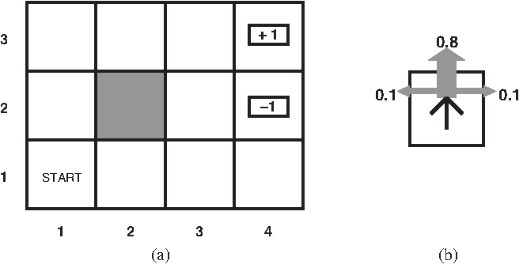
A sequential decision problem that is an MDP
Actions = {Up, Down, Left, Right}

Slide 19
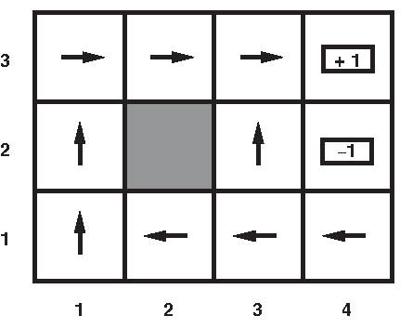
Optimal policy when R(s) = -0.04
Go the long way around except when you’re really close to the +1 terminal state.

Slide 20
Optimal policy when R(s) < -1.6284
Life is too painful. Die as quickly as possible.

Slide 21
Optimal policy when -0.4278 < R(s) < 0.850
Life is difficult.
Head for the +1 state as quickly as possible. Accept the risk of hitting the -1 state.

Slide 22
Optimal policy when -0.0221 < R(s) < 0
Life is tolerable. Avoid the -1 state at all costs.

Slide 23
Optimal policy when R(s) > 0
Life is a feast! Avoid both terminal states and keep on truckin’ forever.
Need exponential discounting to assure convergence of U_{h}.

Slide 24
Policies
A policy π(s) maps states to actions and fully defines an agent’s behavior.
The utility of a state under policy π is the expected total discounted reward:
U^{π}(s) = E ∑_{t=0} 𝛾^{t}R(S_{t})
The optimal policy π*(s) is argmax U^{π}(s).
By the principle of maximum expected utility, π*(s) = argmax ∑_{s’} P(s’ | s,a) ∙ U(s’)
So the true utility of a state is U^{π*}(s).
Note the circularity: π* depends on U, and U depends on π*.
∞
π
a

Slide 25
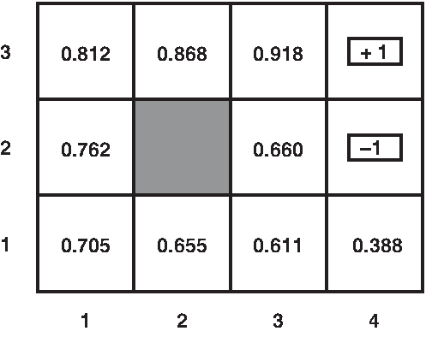
True utilities when R(s) = -0.04 and 𝛾=1

Slide 26
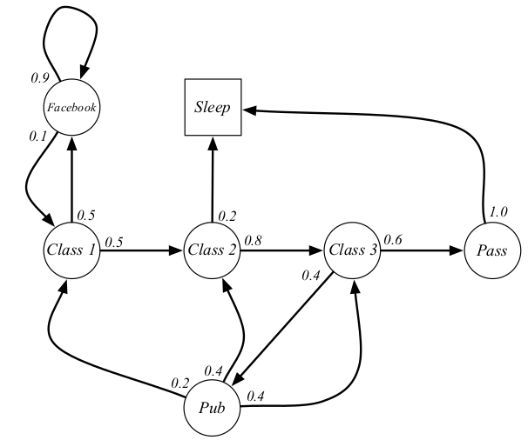
Life of a college student:
a Markovian process.
Figure from David Silver, University College London.

Slide 27
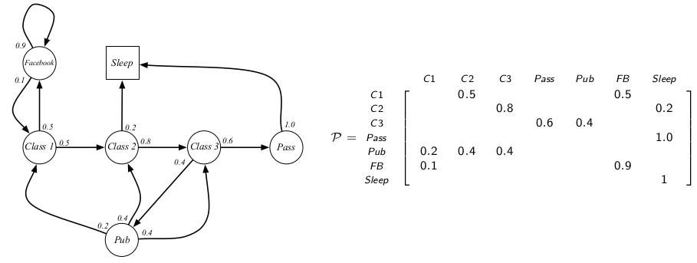
Transition probabilities
Figure from David Silver, University College London.

Slide 28
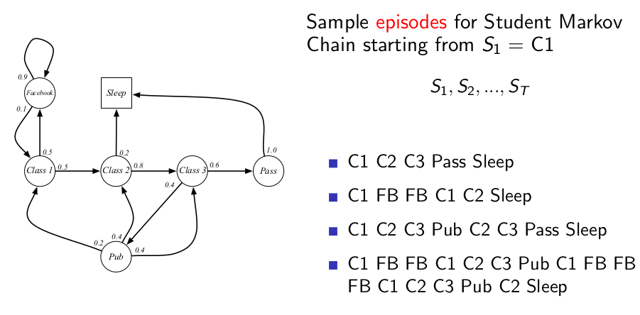
Figure from David Silver, University College London.

Slide 29
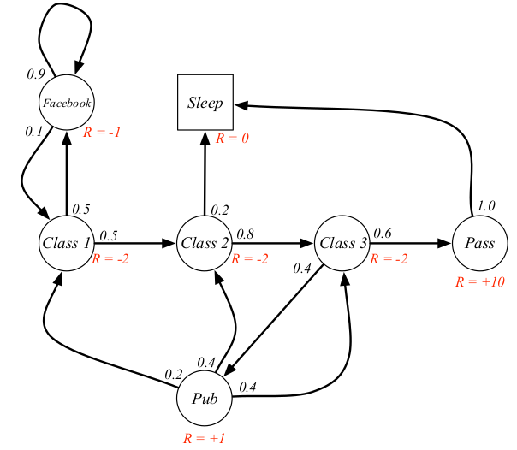
Reward R(s) for each state
A Markovian reward problem.
Figure from David Silver, University College London.

Slide 30
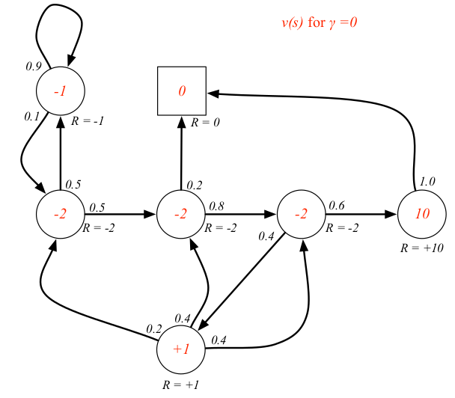
True utility of each state
when 𝛾 = 0 is just the reward R(s).
Figure from David Silver, University College London.

Slide 31
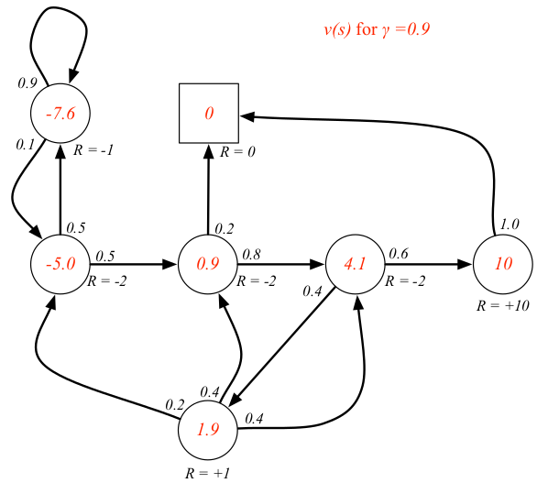
True utility of each state
when 𝛾 = 0.9
Figure from David Silver, University College London.

Slide 32
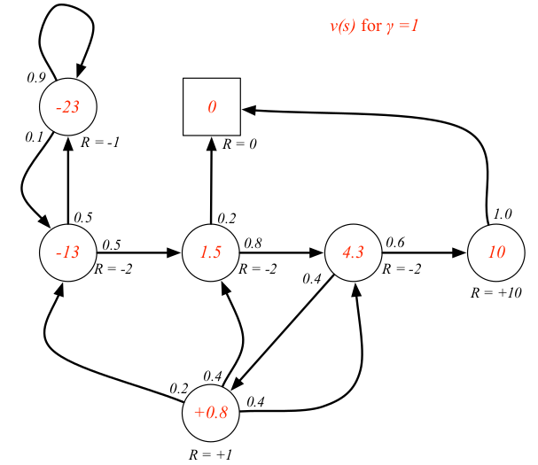
True utility of each state
when 𝛾 = 1 (no discount).
Figure from David Silver, University College London.

Slide 33
Finding Optimal Policies
by Value Iteration

Slide 34
The Bellman equation
A state’s utility depends in part on the utilities of its successor states.
This is expressed by the Bellman equation, which defines U(s) in terms of U(s’):
U(s) = R(s) + 𝛾 max_{a} ∑_{s’} P(s’ | s,a) ∙ U(s’)
Example: for state (1,1) in our simple MDP:
U(1,1) = -0.04 + 𝛾 max [ 0.8 U(1,2) + 0.1 U(2,1) + 0.1 U(1,1), (Up)
0.9 U(1,1) + 0.1 U(1,2), (Left)
0.9 U(1,1) + 0.1 U(2,1), (Down)
0.8 U(2,1) + 0.1 U(1,2) + 0.1 U(1,1) ] (Right)

Slide 35
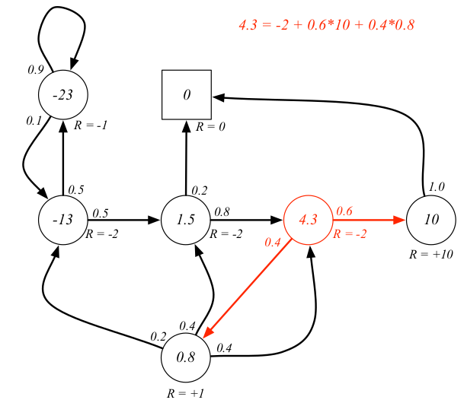
Bellman Equation
Figure from David Silver, University College London.

Slide 36
Value iteration
The Bellman equation describes a steady state for U.
We can reach that state by an iterative computation called value iteration.
Let U_{i}(s) be the utility of state s on the ith iteration.
Bellman update:
U_{i+1}(s) ← R(s) + 𝛾 max_{a} ∑_{s’} P(s’ | s,a) ∙ U_{i}(s’)
Value iteration is guaranteed to converge to a unique solution U*.
A policy π*(s) that uses U* to evaluate actions will be an optimal policy.

Slide 37
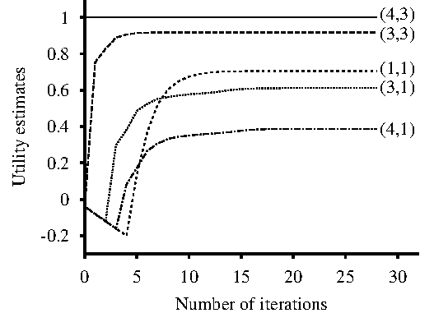
Evolution of utilities during value iteration
Rewards are propagating backward from (4,3) toward (1,1).

Slide 38
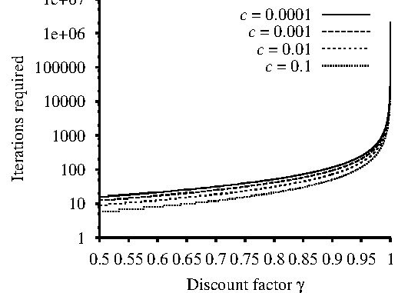
Heavy discounting speeds convergence
Max error is c ∙ R_{max}.

Slide 39
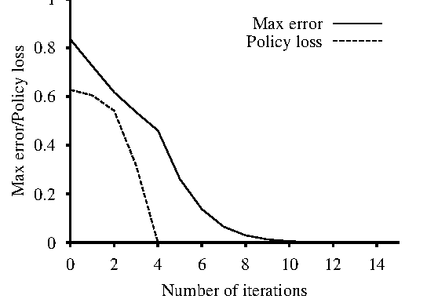
Policy often converges before utility does

Slide 40
Summary
Rational agents act in a way that maximizes the expected utility.
Markov decision processes (MDPs) combine fully visible states with stochastic actions and additive rewards.
Value iteration calculates the true utility of every state in an MDP by iterative Bellman updates. This lets us find the optimal policy.

